Slide 1
Release plan of the data sets (year)
ice production heat/salt flux
Southern Ocean SSM/I available available
AMSR available 2019
Arctic Ocean SSM/I available not planned
AMSR available not planned
Sea of Okhotsk SSM/I 2018 2019
AMSR available available
Sea ice production dataset
→ Validation data for coupled ice-ocean models and analyses
Southern Ocean
Kusahara et al.(2010a, 2010b, 2011), Williams et al.(2010, 2011)
Cougnon et al. (2013), Graham, et al. (2013)
Arctic Ocean Sea of Okhotsk
Kawaguchi et al.(2011) Nakanowatari et al. (2015)
Surface heat and salt flux dataset incorporating sea-ice growth and melt
→ Boundary condition data for various models
Southern Ocean
Galton-Fenzi et al. (2012), Urakawa & Hasumi (2012), Nakayama et al. (2014)

Slide 2
Creation of value-added sea-ice product from passive microwave
Thin ice thickness algorithm of SSM/I and AMSR-E
Calculation of heat flux from the estimated ice thickness
Estimate of sea ice production assuming no oceanic heat
Estimate of salt flux due to brine rejection by ice production
Construction of AMSR
ice thickness algorithm
AVHRR
or
MODIS
Key. et al. (1997)
ECMWF, NCEP
Sea ice surface temp.
AMSR-E
（PR-36,PR-89）
Heat flux calculation
Sea ice thickness (thermal thickness)
compare & validate
(excludes pixels being affected by water vapor)
AMSR ice thickness algorithm in thin ice regions)
+ fast ice (ice shelf, iceberg) detection for the Antarctic case

Slide 3
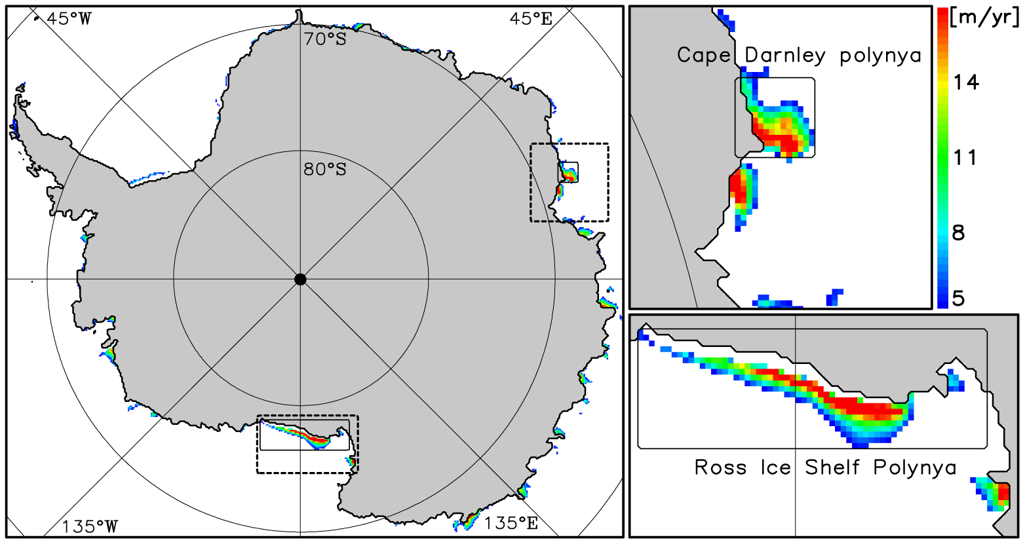
Mapping of annual sea-ice production (1992–2001): Southern Ocean
Cape Darnley
2rd highest production
Ross Sea
Mertz
Highest ice production
(Tamura, Ohshima and Nihashi, 2008, GRL)
Based on heat flux calculation and SSM/I (passive microwave)

Slide 4
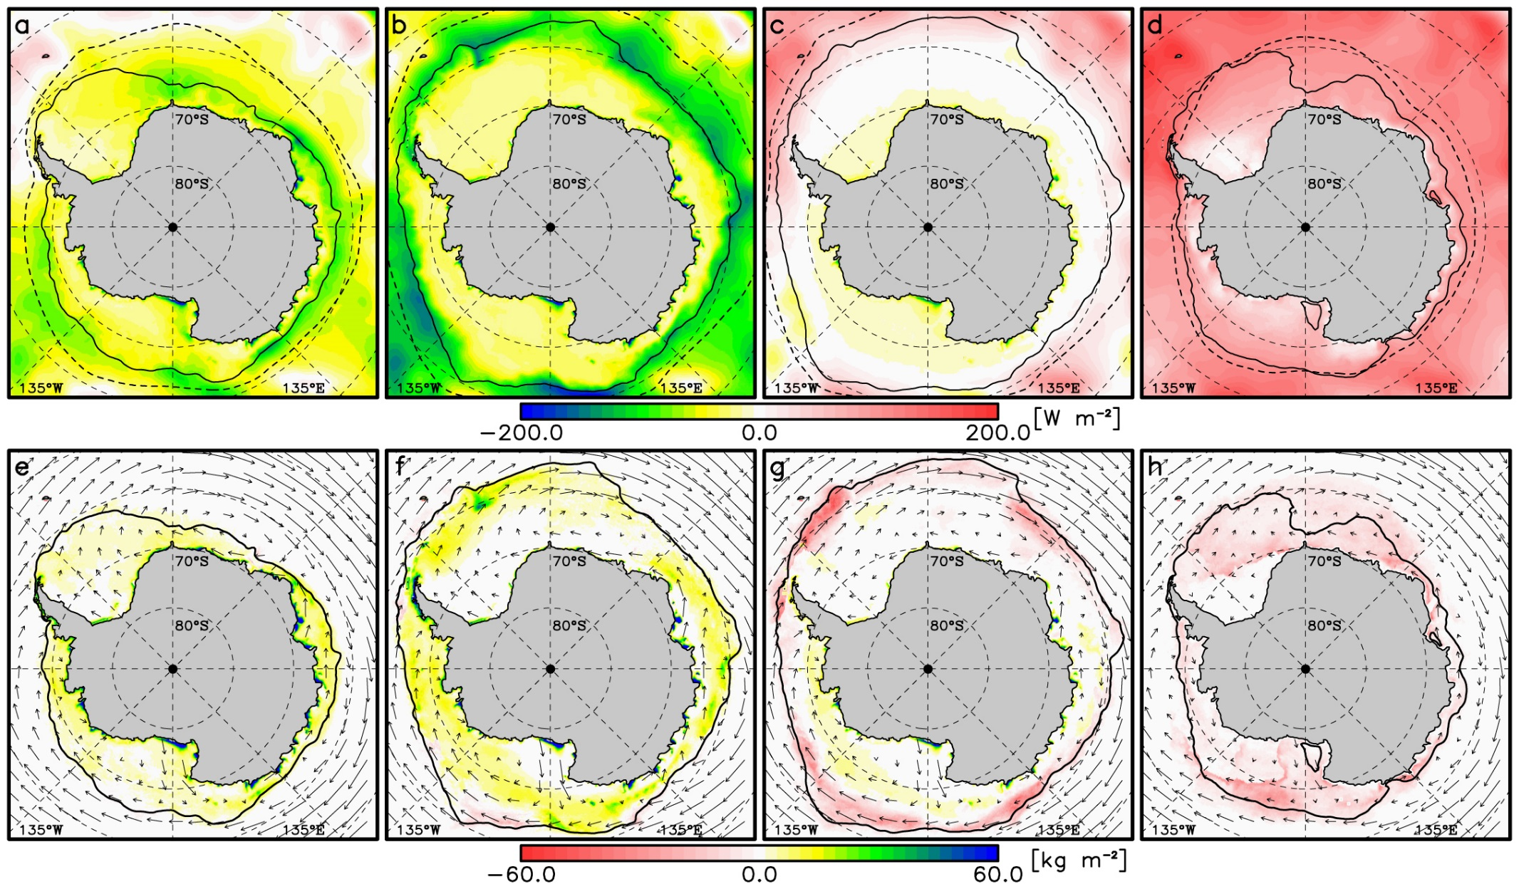
Mapping of seasonal mean surface heat- and cumulative salt-flux (1992-2007)
(Mar-May)
(Jun-Aug)
(Sep-Nov)
(Dec-Feb)
Tamura et al. (2011)

Slide 5
Mapping of annual sea-ice production (2002-2011): Arctic Ocean
Based on
AMSR-E
Iwamoto et al.,
(2014, JGR)

Slide 6
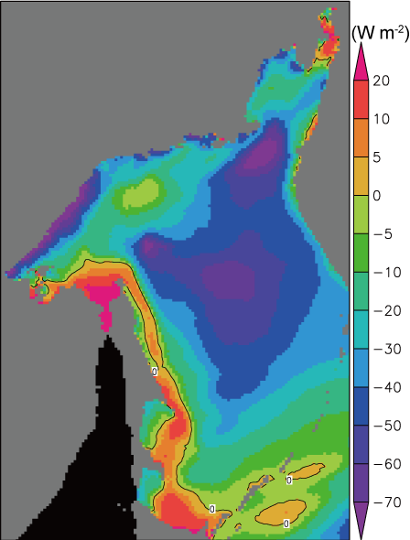
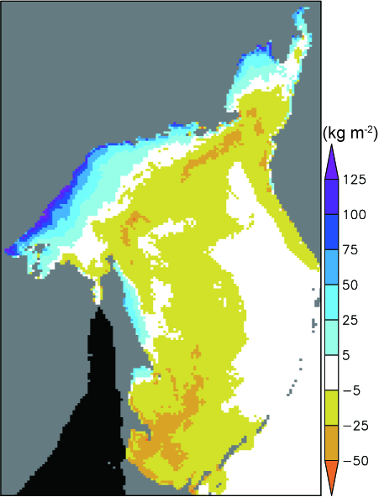
Annual mean heat flux
Sea of Okhotsk
Annual cumulative salt flux
[W m⁻²]
[kg m⁻²]
Negative: in coastal polynya
(heat flux to atmosphere)
Positive: in the south
freezing：
brine rejection
Ice production
(Negative) heat transport by
ice and East Sakhalin Current
melting:
desalinization
Transport
of sea ice
(negative heat)
-28 W m⁻²
Ice melting
melting:
desalinization
Positive：heat flux from atmosphere to ocean
Nihashi et al. (2012, JC)

Slide 7

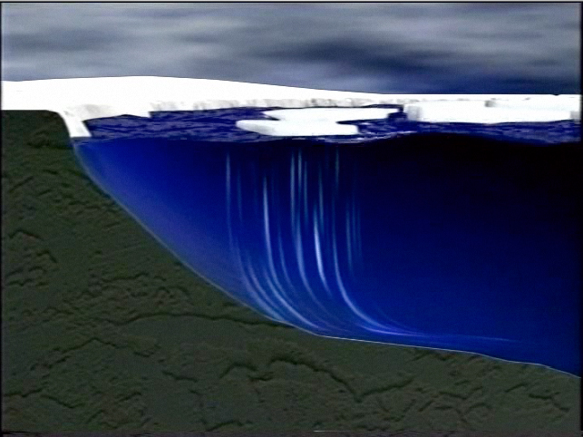
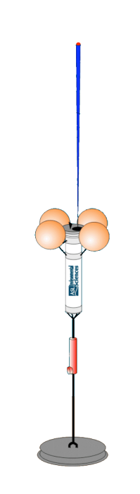
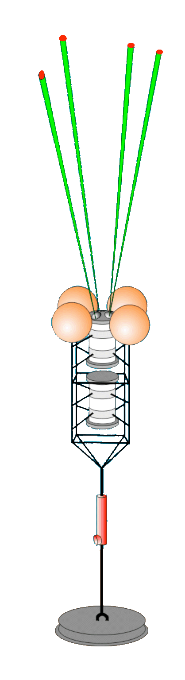
Satellite truth observation
Microwave radiometer
PALSAR, ASAR
coastal polynya
ADCP
(ice drift)
Ice Profiling Sonar (IPS)
Combined IPS &ADCP moorings
↓
Sea ice thickness & topography data
with high temporal resolution
↓
Very good satellite truth data
Chukchi Sea coastal polynya
with UA (Drs. Eicken & Mahoney)
2009 Jul. – continue
Cape Darnley polynya (Antarctic)
by JARE
2010 Feb. – 2011 Feb. (recovered)
2013 Feb. – continue

